Slide 1

IFN649 Advanced Networks Presentation
>Unit Coordinator: Professor Raja Jurdak
>Lecturer: Dr. Gowri Ramachandran
>Tutor: Mr. Tao Liu >Student Name : Yin Chung HO
>Student ID: 11206322

Slide 2


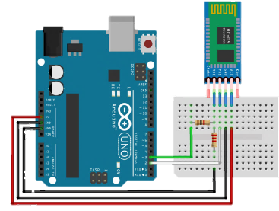
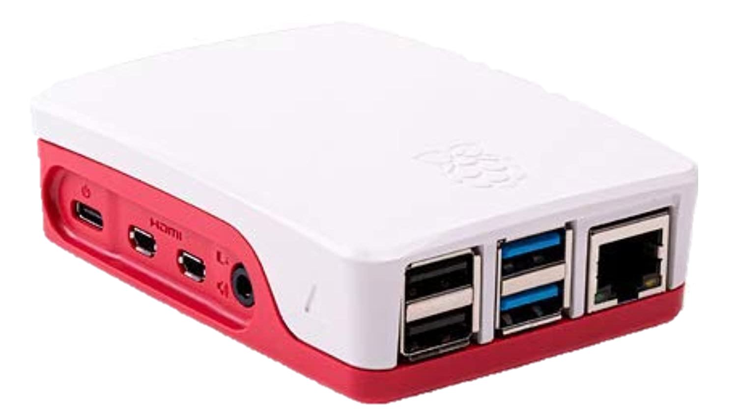
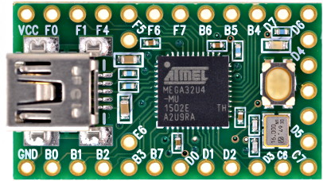


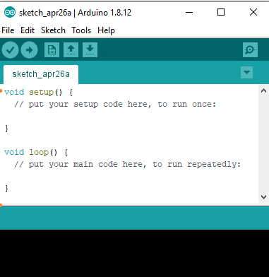
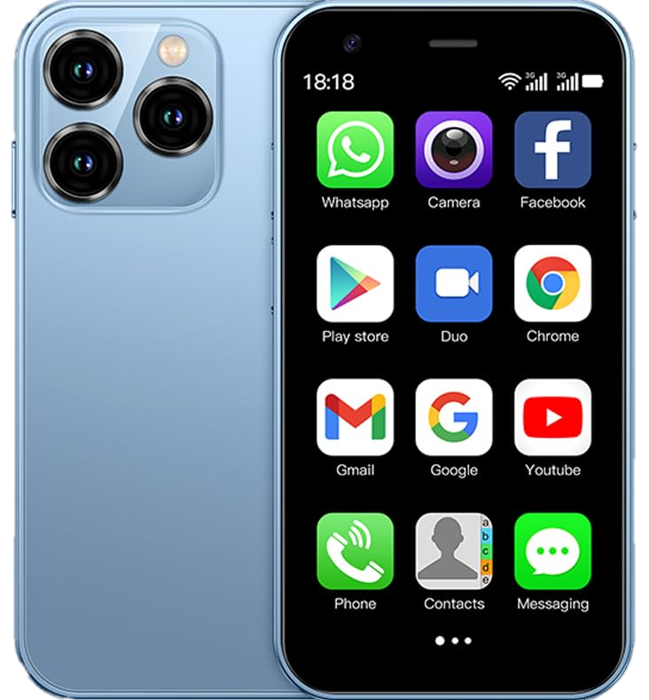
Sensing tier
Cloud tier
Upstream communication
Bluetooth HC—05
Edge tier
Receives “LED_ON”
MQTT on AWS EC2
Cloud
Raspberry Pi
Client.py
Teensy On beensy PCB board
Subscriber
Publish “LED_ON”
Publish “LED_ON”
Program in Teensy
Publish.py
Publisher
Display “LED_ON”
Web Client Devices
Publisher
Downstream communication
Notes:
Upstream communication happens when you send data from lower tiers to upper tiers.
Downstream communication happens when you send data from upper tiers to lower tiers.

Slide 3

T2 Send Temp. data to laptop from Teensy
The main purpose of this code (C++) is to collect environmental data (such as Temperature and Humidity) from the DHT11 sensor through the Bluetooth module (HC-05) and transmit this data to other devices (PC).
At the same time, LED indicators are used to display the data transmission status.
The Bluetooth communication rate is set to 9600 bps and the LED lights up while transmitting data.
#include "DHT.h“ Import DHT library
//#include <SoftwareSerial.h>
#define DHTPIN 21 // Digital pin connected to the DHT sensor Set the digital pin connected to the sensor
#define DHTTYPE DHT11 // DHT 11 sets the sensor type #define LEDPIN 11 defines digital pin 11 controls LED, used to indicate if the BT module is sending data
DHT dht(DHTPIN, DHTTYPE); Initialize DHT sensor // Teensy 5V <--> HC-05 Vcc
// Teensy Ground <--> HC-05 GND
#define rxPin 7 // Teensy pin 7 <--> HC-05 Tx Define the receiving and transmitting pins
#define txPin 8 // Teensy pin 8 <--> HC-05 Rx connected to the Bluetooth module HC-05
//SoftwareSerial BTSerial = SoftwareSerial(rxPin, txPin);

Slide 4
void setup() {
// Setup serial for monitor View data via the serial monitor of the Arduino IDE
Serial.begin(9600); comm. rate 9600 bps
// Setup DHT Sensor
pinMode(DHTPIN, INPUT); Set the sensor pin to input
dht.begin(); and enable the DHT sensor
// Setup Serial1 for Bluetooth
Serial1.begin(9600);
// Default communication rate of the Bluetooth module
}
void loop() {
if(Serial1.available() == 0){
// Checks whether data is comming from the serial port
digitalWrite(LEDPIN, HIGH); LED Turn on to indicate data transfer
float h = dht.readHumidity(); Read sensor data
float t = dht.readTemperature();
float f = dht.readTemperature(true);
float hif = dht.computeHeatIndex(f, h);
float hic = dht.computeHeatIndex(t, h, false);
Serial.print(F(" Humidity: ")); Output data to monitor
Serial.print(h);
Serial.print(F("% Temperature: "));
Serial.print(t);
Serial.print(F("C "));
Serial.print(f);
Serial.print(F("F Heat index: "));
Serial.print(hic);
Serial.print(F("C "));
Serial.print(hif);
Serial.println(F("F"));
Serial1.print(F(" Humidity: ")); Transfer data via BT
Serial1.print(h);
Serial1.print(F("% Temperature: "));
Serial1.print(t);
Serial1.print(F("C "));
Serial1.print(f);
Serial1.print(F("F Heat index: "));
Serial1.print(hic);
Serial1.print(F("C "));
Serial1.print(hif);
Serial1.println(F("F"));
delay(1000);
digitalWrite(LEDPIN, LOW); Delay and turn off LED
delay(1000);
}
}

Slide 5

T3 Send temp. data to Raspberry Pi from Teensy
The code is used to continuously monitor the Bluetooth serial port (/dev/rfcomm0) and communicate with the Arduino.
When communication starts, the code sends the "Start\r\n" command to the Arduino. Afterwards, it continuously checks to see if there is data to read from the serial port, reads the data, then decodes and displays it on the console.
import serial 匯入必要的庫
import time
import string
# reading and writing data from and to arduino serially.
# rfcomm0 -> this could be different
ser = serial.Serial("/dev/rfcomm0", 9600) 設定串口連接,通信速率為 9600 bps
ser.write(str.encode('Start\r\n’)) 向 Arduino 發送初始訊息
while True: 主循環
if ser.in_waiting > 0: 檢查是否有數據可讀取
rawserial = ser.readline() 從串口讀取一行數據
cookedserial = rawserial.decode('utf-8').strip('\r\n’) 將讀取的字節數據解碼為 UTF-8 格式的字符串
print(cookedserial) 將處理後的字符串輸出到控制台

Slide 6

T5 Client -> Subscriber
This code subscribes to a specified MQTT topic “ifn649”and sends the received messages to a hardware device (Arduino).
import paho.mqtt.client as mqtt Import client libraries handle the
MQTT protocol
import serial
def on_connect(client, userdata, flags, rc):
# Function for making connection Called when the client
successfully connects
print("Connected to MQTT")
print("Connection returned result: " + str(rc) )
client.subscribe("ifn649") Subscribe to topic "ifn649 "
def on_message(client, userdata, msg):
# Function for Sending msg When rec. a msg from a sub. topic
print(msg.topic+" "+str(msg.payload)) Print msg subject and payload ser = serial.Serial("/dev/rfcomm0", 9600)
ser.write(str.encode(str(msg.payload))
client = mqtt.Client() Create an MQTT client
client.on_connect = on_connect
client.on_message = on_message
client.connect("test.mosquitto.org", 1883, 60)
Connect MQTT client to proxy server
client.loop_forever() Start MQTT network loop
Notes:
功能：該程式碼控制一個 LED 的開關，通過 Bluetooth 接收指令來操作 LED。說明：初始化序列埠通訊，設定 Bluetooth 序列埠 Serial1 和標準序列埠 Serial。
從 Bluetooth 序列埠讀取命令，並根據命令（"LED_ON" 或 "LED_OFF"）控制連接到引腳 11 的 LED。
在序列埠監視器上列印 LED 的狀態。

Slide 7

T5 publisher -> publisher
This code uses the publish module from the MQTT library to publish an MQTT message "Hello World" to the specified topic "ifn649” Subscriber to the MQTT broker server at test.mosquitto.org by using the MQTT protocol.
import paho.mqtt.publish as publish Import the publish module
publish.single("ifn649", "Hello World", hostname="test.mosquitto.org”, port=1883)
“ifn649”=MQTT topic, "Hello World“= Msg to be published , hostname = Proxy server
print("Done")
Notes:
功能：該程式碼使用 MQTT 協議將一條消息發佈到指定的 MQTT 主題。說明：使用 paho-mqtt 庫的 publish 模組，向主題 "ifn649" 發佈消息 "Hello World"。
MQTT 代理伺服器的主機名為 test.mosquitto.org。
程式碼完成後列印 "Done" 以確認消息已發佈。

Slide 8

T5 Controller (Arduino)
It controls the switch of an LED and receives instructions via Bluetooth connect with Raspberry Pi to operate the LED.
void loop() { Receive commands from BT
// Process commands from bluetooth first.
if(Serial1.available() > 0){ Check if there is data readable from
the BT serial port
String str = Serial1.readString().substring(2);
str = str.substring(0, str.length() - 1);
//Serial.println(str);
if(str == "LED_ON"){ If the rec. str. is "LED_ON"
digitalWrite(LEDPIN, HIGH); light up LED
Serial.println("LED ON"); Print "LED ON" on the monitor
}
else if(str == "LED_OFF"){
digitalWrite(LEDPIN, LOW);
Serial.println("LED is OFF");
}
}
}
#define LEDPIN 11
void setup() { Initialize serial port
// Setup serial for monitor and Setup Serial1 for BlueTooth
Serial.begin(9600); for monitoring
Serial1.begin(9600); Bluetooth module
pinMode(LEDPIN, OUTPUT);
Config LED pins for output mode
}
Notes:
初始化：
設定序列埠通訊（用於監視和 Bluetooth 模組）。
組態 LED 引腳為輸出模式。
循環：
從 Bluetooth 接收命令。
根據接收到的命令控制 LED 的開關狀態，並在序列埠監視器上反饋狀態。

